Slide 1
Control Flow
Jump Statements
[Unconditional Jumps]
Rajasekaran S
Assistant Professor,
Department of Information Technology,
KGiSL Institute of Technology,
email: proffraja@gmail.com
Github:www.github.com/rajasekaranap

Slide 2
Unconditional Statements
It transfers the control from one part of the program to another part of the program without any checking of condition.
This statements doesn't have any conditions to verify.
As soon as the execution encounters these statements immediately the jump has been made.
There are two types of statements
Continue
Break

Slide 3
Continue Statement
The continue statement is used in loop control structure when you need to immediately jump to the next iteration of the loop.
It can be used with for loop or while loop.
The Java continue statement is used to continue loop.
It continues the current flow of the program and skips the remaining code at specified condition.

Slide 4
Syntax
loop {
//block of code [stage 1]
continue;
//block of code [stage 2]
}
Stage 2 block will not execute due to the encounter of continue.
It simply moves to begging of the loop.

Slide 5
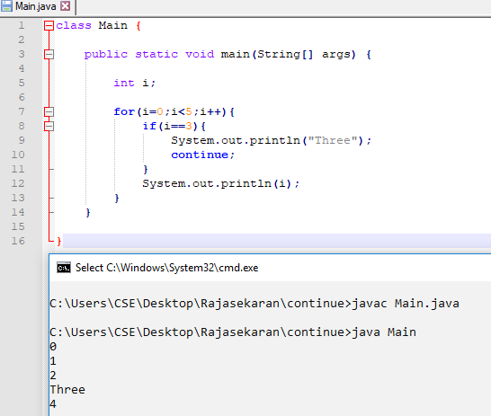
Example

Slide 6
Explanation
Program try to print the numbers from 0 to 4.
Every time loop executes the current value of i is printed.
While we encountering i value is 3.
String “Three” is printed instead of Number 3.
Even consecutive statements [Line 12] has ready print number 3 it is ignored by continue.
Continue statement moves the control to the beginning of the loop so the remaining statements are ignored for that iteration.

Slide 7
Break Statement
It is used to break the flow and moves out the control from current block.
When the break statement is encountered inside a loop, the loop is immediately terminated and the program control resumes at the next statement following the loop.
It can be used to terminate a case in the switch statement (covered in the next chapter).

Slide 8
Syntax
loop {
//block of code [stage 1]
break;
//block of code [stage 2]
}
Stage 2 block will not execute due to the encounter of break.
It simply breaks the loop and there is no more iterations.

Slide 9
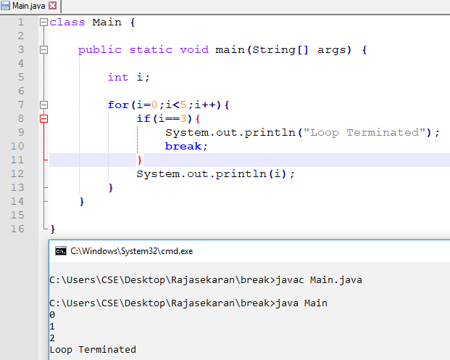
Example

Slide 10
Explanation
Program try to print the numbers from 0 to 4.
Every time loop executes the current value of i is printed.
While we encountering i value is 3.
It prints “Loop Terminated”.
Break Statement is encountered so the loop is terminated immediately.
Even 1 more iterations is available to complete total number of iterations expected but loop is terminated due to break statement.

Slide 11
Thank You
Rajasekaran S
Assistant Professor,
Department of Information Technology,
KGiSL Institute of Technology,
email: proffraja@gmail.com
Github:www.github.com/rajasekaranap

